Slide 1
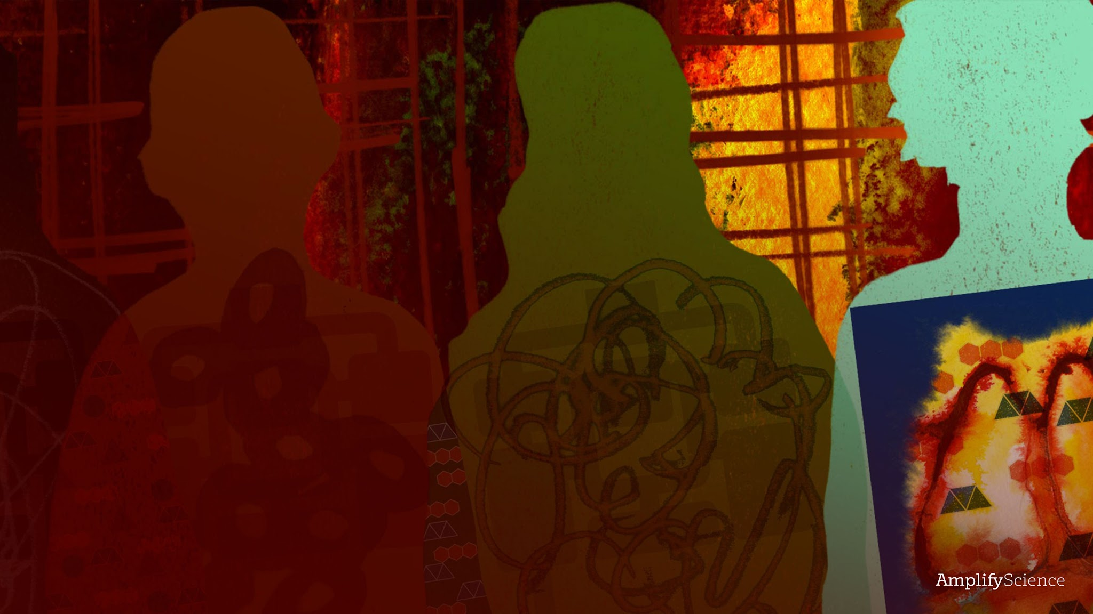
Metabolism
Lesson 2.2: Patient Stories: Problems with Body Systems

Slide 2
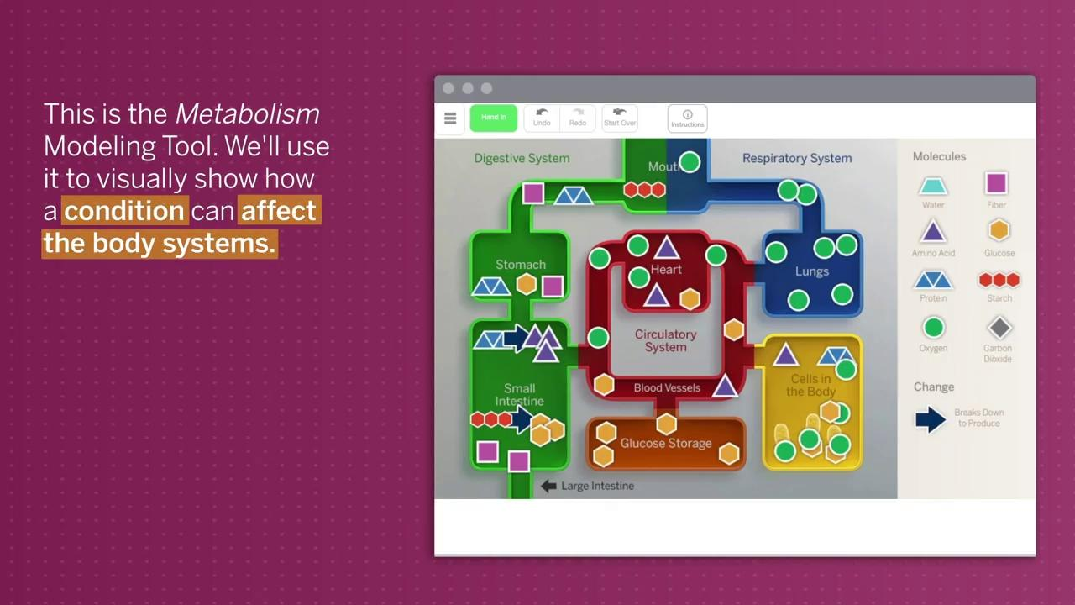

Slide 3
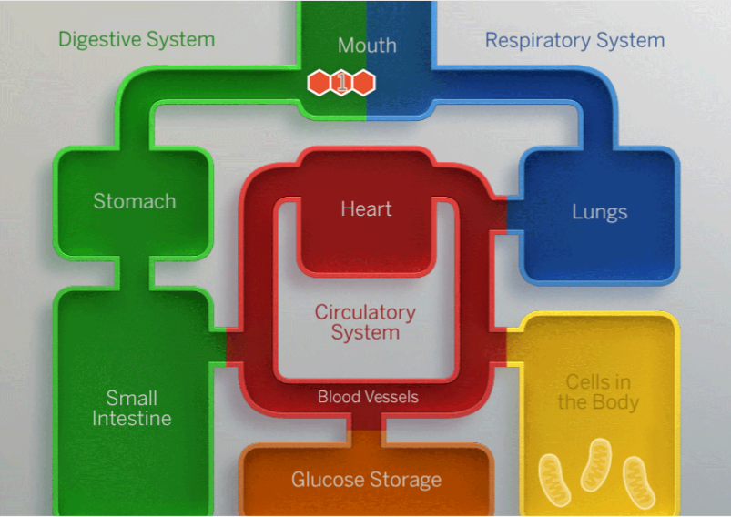
Warmup
Add molecules along the path they take in the body until they reach the cell. Use only as many molecules as you need to show the path.
A number 1 has been added to the starch molecule to show where this molecule starts its path through the body. Add a number 2 where you think the molecule goes next. Continue to add numbers until the molecules reach the cell.
If a molecule breaks down into smaller molecules, use an arrow to represent this process.
If you have time, show the path molecules from air take through the body to reach the cell.
Tip: A starch molecule has been placed in the mouth because starch is in food.
Goal: Model your ideas about how molecules from food and the air get to the cells in the body.

Slide 4
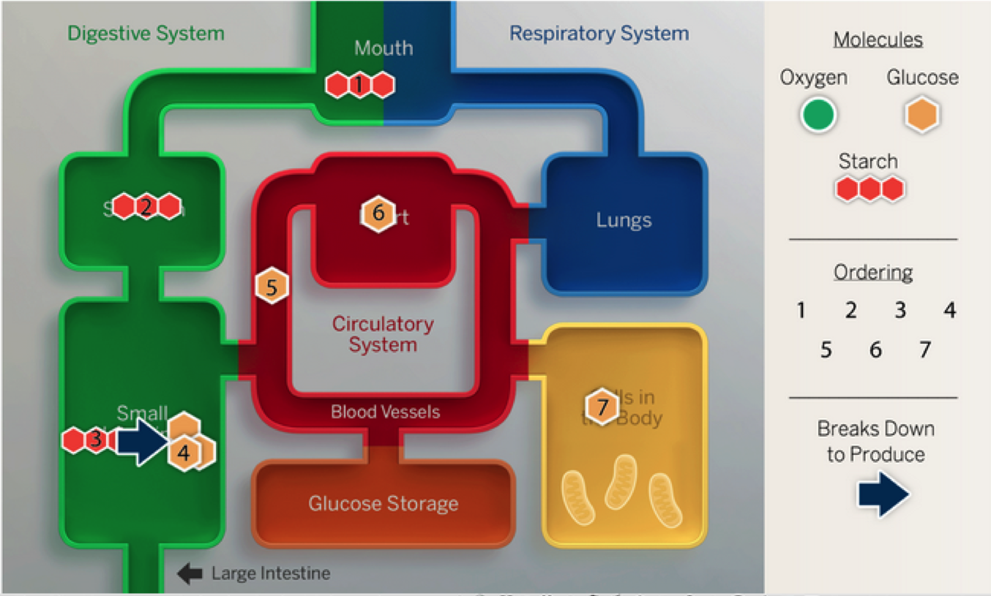
Warmup

Slide 5
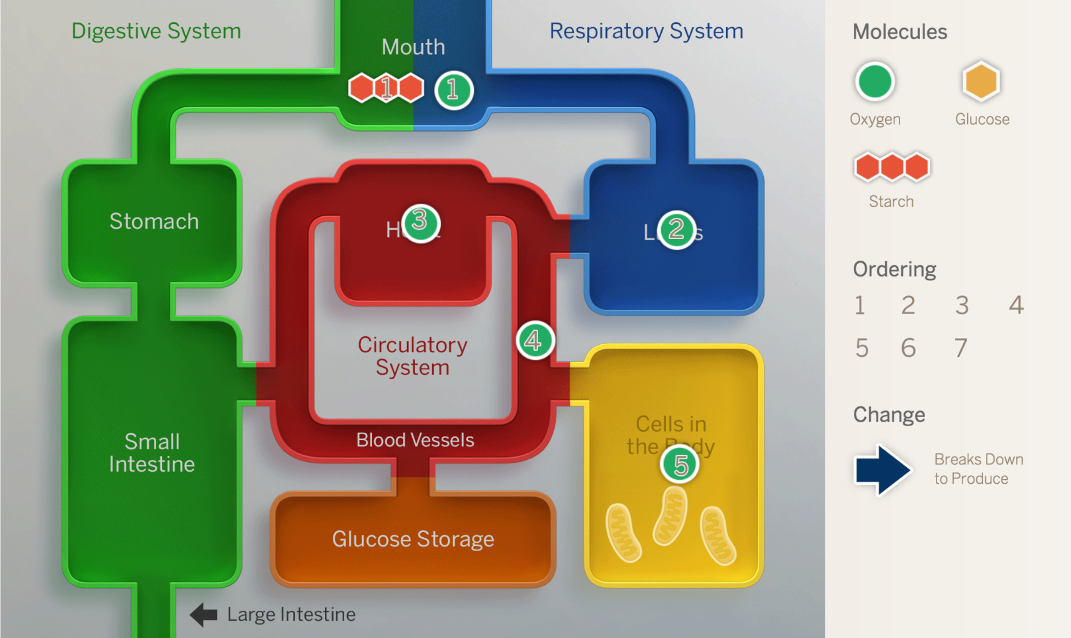
Warmup

Slide 6
Key Concept #6:
In a functioning human body, body systems work together to deliver glucose, oxygen, and amino acid molecules to the cells in the body.

Slide 7
Key Concept #5a:
Systems can work together to form a larger more complex system.

Slide 8
system
a set of interacting parts forming a complex whole

Slide 9
digestive system
the body system that takes in food and breaks it down

Slide 10
respiratory system
the body system that takes in oxygen and releases carbon dioxide

Slide 11
circulatory system
the body system that transports molecules to and from all cells of the body

Slide 12
Investigation Question:
How can having a medical condition affect the delivery of molecules to cells in the body?

Slide 13
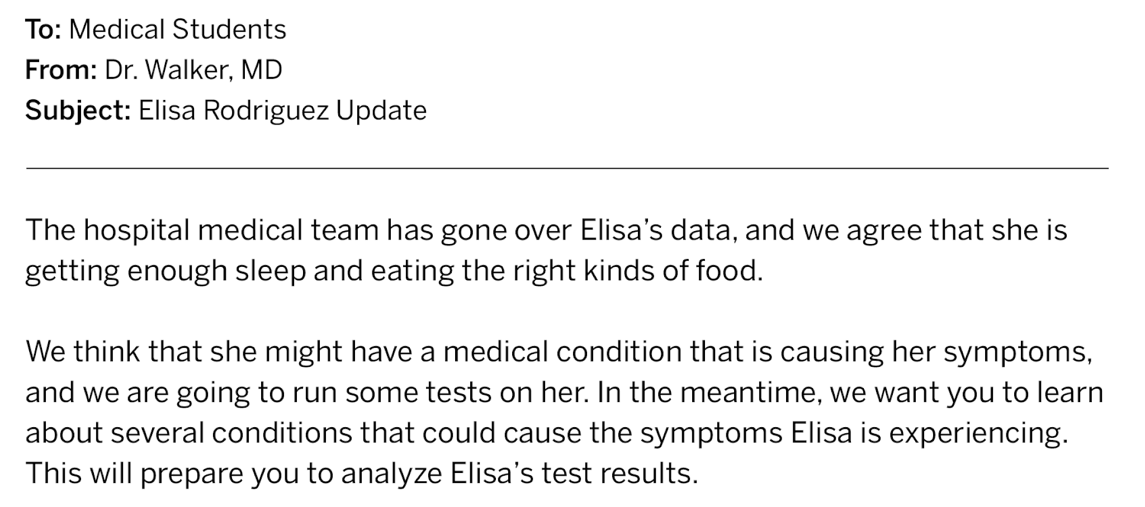
Active Reading: Patient Stories Article Set

Slide 14
Claims About Elisa's Condition:
Claims About Elisa's Condition
Elisa is feeling tired because she has diabetes.
Elisa is feeling tired because she has anemia.
Elisa is feeling tired because she has an injury to her pancreas.
Elisa is feeling tired because she has asthma.
You will work in groups. Each member will be responsible for learning about one of the four conditions so that we can diagnose Elisa.
  Diabetes
  Anemia
  Pancreas
  Asthma

Slide 15
Question Starters
Think about these question starters while reading your article and how you would answer them.
What causes . . . ?
Is this evidence of . . . ?
Does this support the claim that . . . ?
Is this like (another idea or activity from class)?
Why did . . . ? Why didn't . . . ?
Would it be better if . . . ?
Who . . . ? What . . . ? When . . . ? Where . . . ? Why . . . ?
How . . . ? Can . . . ?

Slide 16
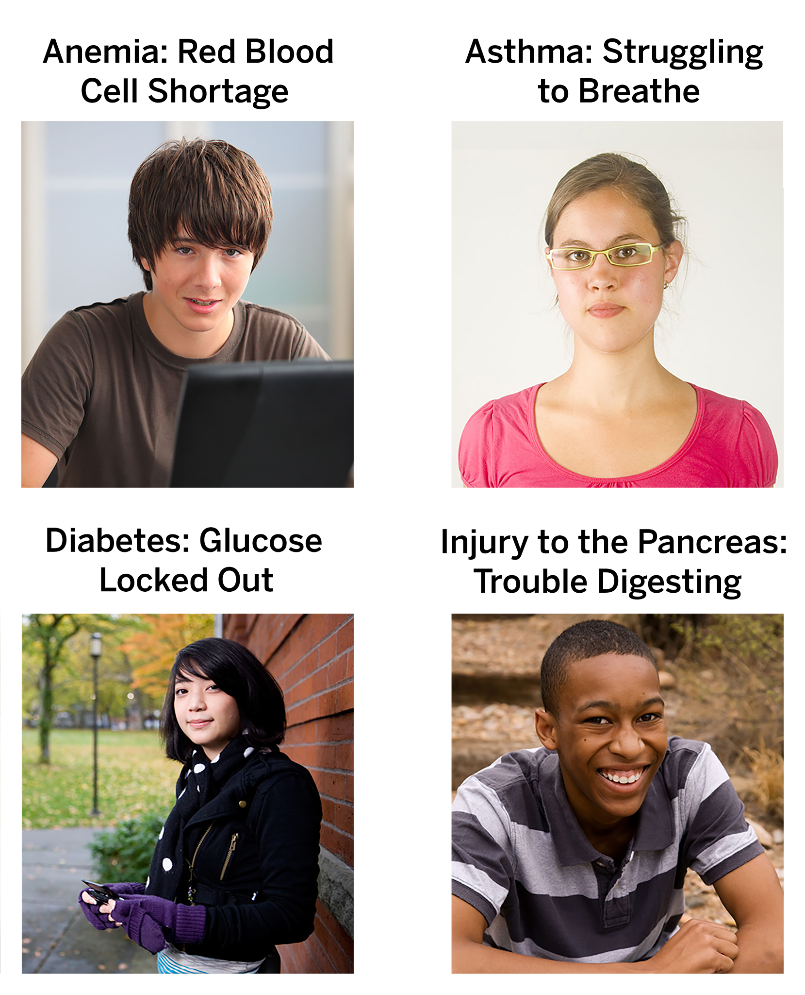
Discussing Annotations
Raise your hand if the condition you read about involved oxygen.
What about glucose?
Pair up with someone who read an article involving problems with the same molecule.
Since you each read different articles, this discussion will be slightly different. You’ll need to make sure your partner understands the condition you read about.
You will start by explaining what your condition is and how it affects the body, using illustrations and visuals from the article.

Slide 17
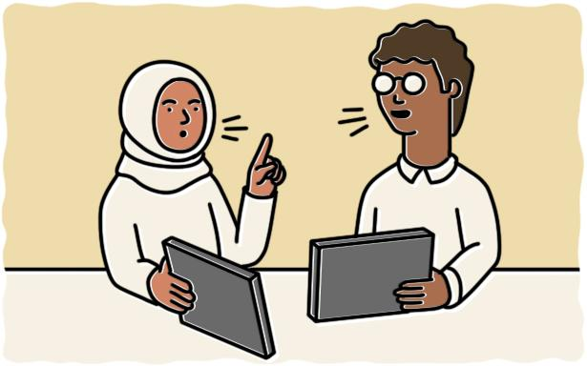
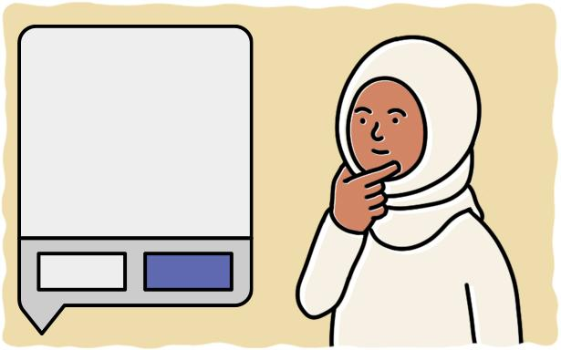
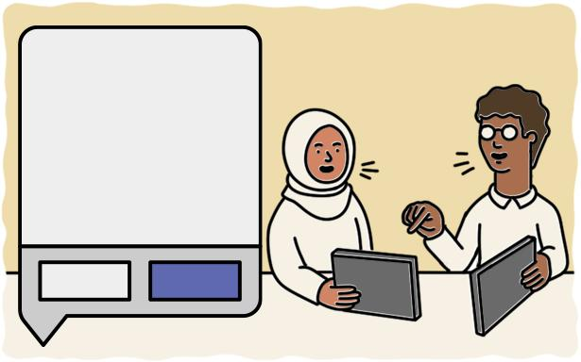
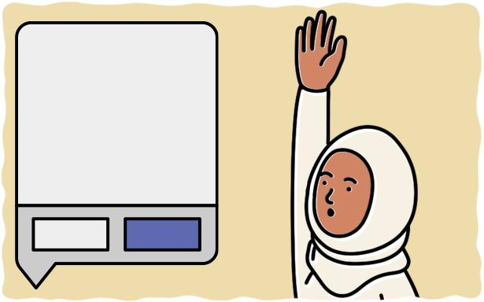
Discussing Annotations
#share
#discussed
#present
1: Explain
2: Prepare to Share
3: Discuss
4: Prepare to Present
Explain what your condition is and how it affects the body, using illustrations and visuals from the article.
Choose an interesting question or connection to share with a partner.
Tag it with #share.
Talk about your chosen annotation with a partner.
Tag it with #discussed if you resolved your questions.
Choose an interesting or unanswered question to present to the class.
Tag it with #present.

Slide 18
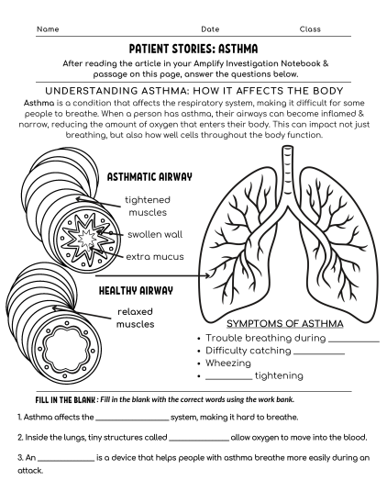
Discussing Annotations
Take notes as each of the students present their patient story. Then answer the reflection question on each of the given article pages

Slide 19
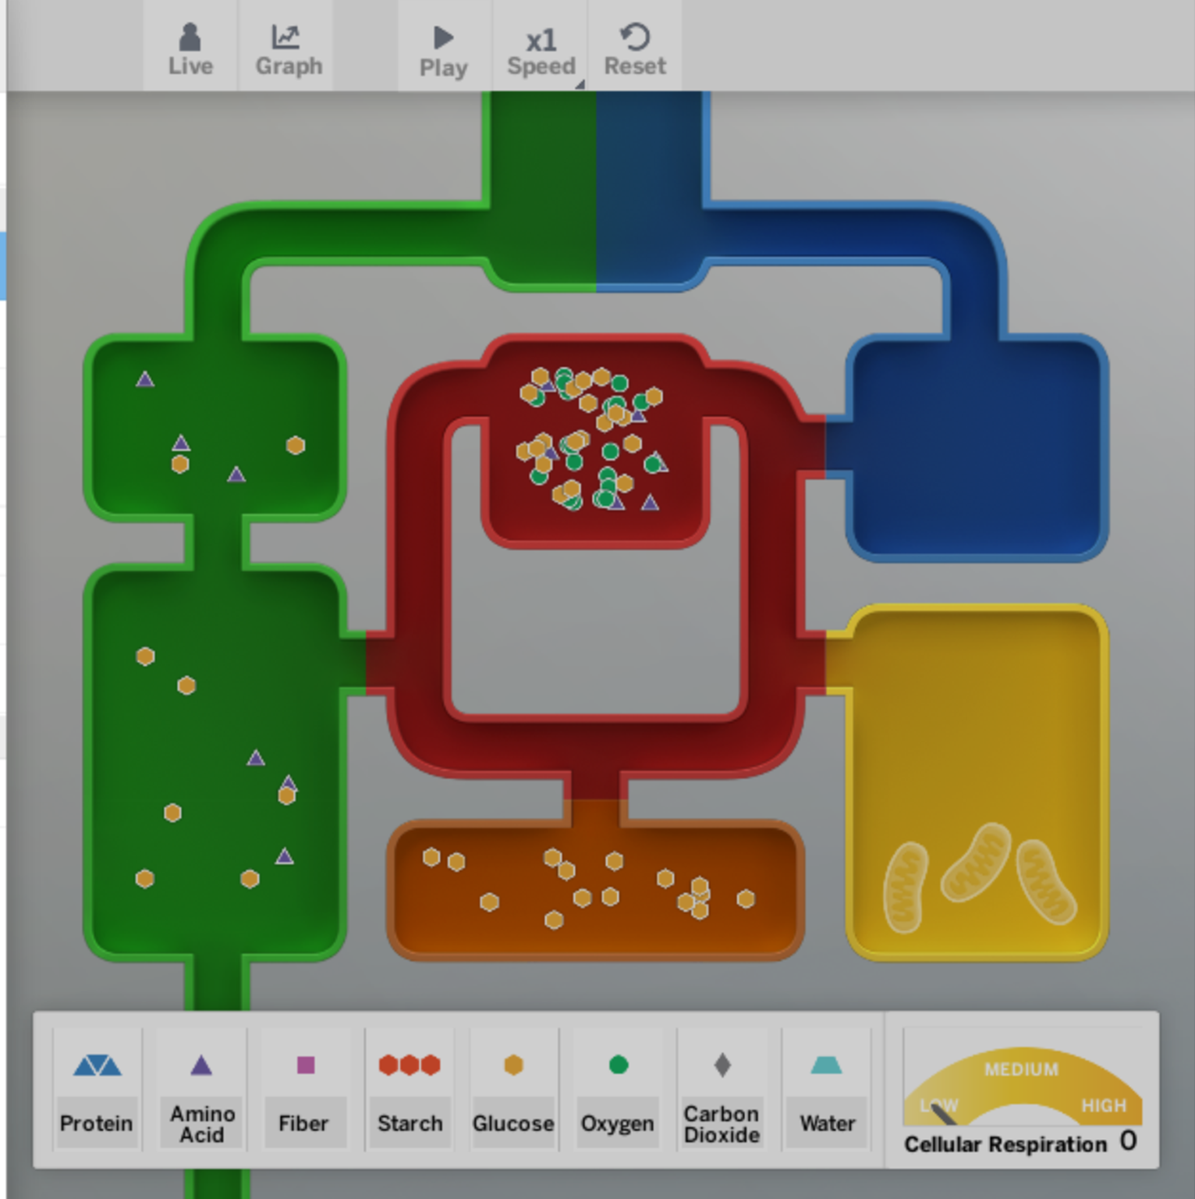
Homework
For this activity, you will use the Sim to select the condition you read about (anemia, asthma, diabetes, or pancreas injury) and observe what happens to the body.
Choose the condition you read about (Anemia, Asthma, Diabetes, or Pancreas Injury), and then select OBSERVE.
Feed and observe the body.
Record your observations and questions.

